Slide 1

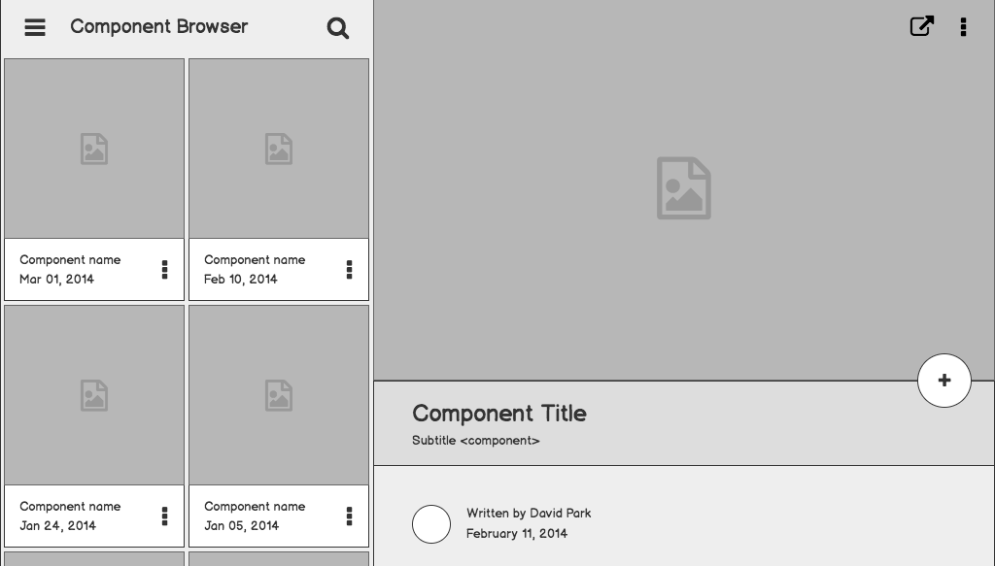

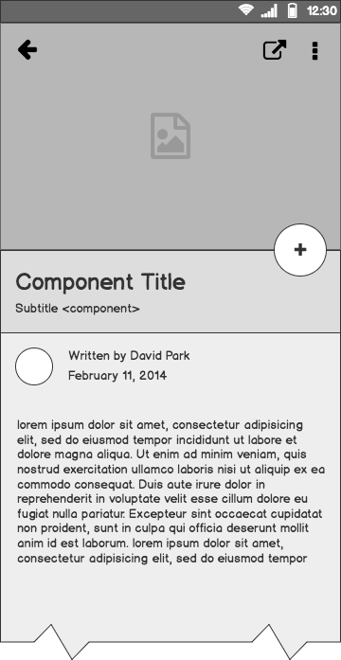
Low Level Design
Amazon Sales Data Analysis

Slide 2
Document Overview
Document Version : 1.0
Date : 29-09-2023

Slide 3
Table of Contents
Purpose
Scope
Project Introduction
Problem Statement
Dataset
Architecture
Deployment

Slide 4
Purpose
To reveal concealed profit and sales patterns, and offer vital insights into the factors influencing business outcomes, enabling stakeholders to make informed decisions.

Slide 5
Scope
Low-level design (LLD) is a component-level design process that follows a step-by-step refinement process. The process can be used for designing data structures, required software architecture, source code and ultimately, performance algorithms. Overall, the data organization may be defined during requirement analysis and then refined during data design work.

Slide 6
Project Introduction
This is a project about Sales Management. Organizations under the E-commerce industry seek to attain core competence by creating and sustaining a unique process to collect personal information about customers and their purchasing trends. The report critically evaluates how service-based organizations -Amazon use Management information systems to attain competitive advantage through efficient management and acquisition of information. The purpose of this project is to analyze Amazon Sales Data to obtain meaningful information. To do that, a Sales dataset is provided, which includes sales amount, list price, cost price, etc.

Slide 7
Problem Statement
Sales management has gained importance to meet increasing competition and the need for improved distribution methods to reduce cost and increase profits. Today, sales management is the most important function in a commercial and business enterprise. Do ETL: Extract-Transform-Load some Amazon dataset and find for me Sales-trend -> month-wise, year-wise, yearly-month wise. Find key metrics and factors and show the meaningful relationships between attributes.

Slide 8
Dataset
Invoice Date: Day on which Invoice generated.
Discount Amount: Total discount provided on any item.
Sales Amount: Total Sales Price of an Item.
Sales Margin Amount (Profits): Sales Margin Amount is a difference of Sales Cost Amount & Sales Amount.
Sales Cost Amount: Total Cost Price of any Item.
Sales Price: Sales Price of any particular Item.

Slide 9
Architecture
1

Slide 10
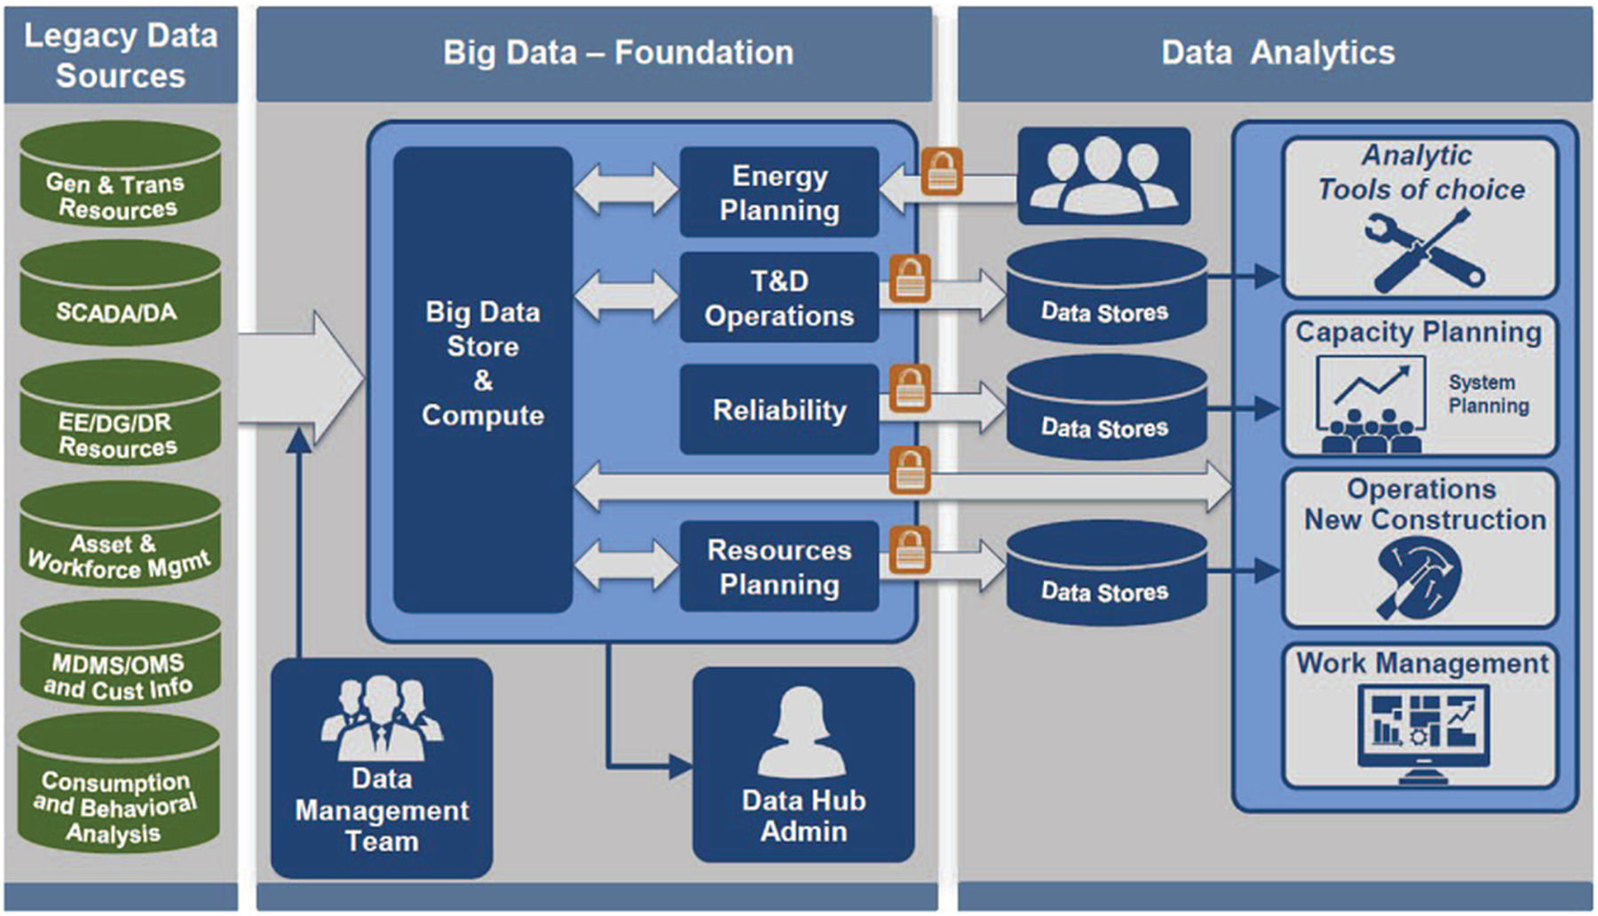

Slide 11
Data Collection
The Dataset was taken from iNeuron’s Provided Project Description Document.
https://docs.google.com/spreadsheets/d/1h3EsPf-fTLrzpP7sGeyuRnGBXrdJRcXY/edit?usp=sharing&ouid=105519103382792804653&rtpof=true&sd=true

Slide 12
Data Cleaning
Data cleaning is the process of fixing or removing incorrect, corrupted, incorrectly formatted, duplicate, or incomplete data within a dataset.
a) Remove duplicate or irrelevant observations
b) Filter unwanted outliers
c) Renaming required attributes

Slide 13
Exploratory Data Analysis
Exploratory Data Analysis refers to the critical process of performing initial investigations on data to discover patterns, spot anomalies, test hypotheses and check assumptions with the help of summary statistics and graphical representations.

Slide 14
Reporting
Reporting is a most important and underrated skill of a data analytics field. Because being a Data Analyst you should be good in the easy and self-explanatory report because your model will be used by many stakeholders who are not from a technical background.
a) High-Level Design Document (HLD)
b) Low-Level Design Document (LLD)
c) Architecture
d) Wireframe
e) Detailed Project Report

Slide 15
Modelling
Data Modelling is the process of analyzing the data objects and their relationship to the other objects. It is used to analyze the data requirements that are required for the business processes. The data models are created to store the data in a database. The Data Model's main focus is on what data is needed and how we have to organize data rather than what operations we have to perform.

Slide 16
Deployment
1

Slide 17
